Slide 1
IHSS Overview Senate Budget - Sub 3 Hearing March 2, 2017
California Department of Social Services
Will Lightbourne, Director
Pete Cervinka, Chief Deputy Director
Debbi Thomson, Deputy Director

Slide 2
In-Home Supportive Services (IHSS)
The IHSS Program has a long rich history of service and has been in operation for over 40 years. It is the largest program of its kind in the United States.
Key tenets of IHSS:
It affords recipients the ability to remain safely in their homes/communities in lieu of institutionalization.
Recipients direct the care including: hiring/firing, scheduling, training and supervising their provider
California is a national leader in providing home and community based services. It is one of only three states that has successfully “rebalanced” long-term supports and services to home and community based care.
CA spends over 54% on long term care costs for home and community-based services (HCBS).
IHSS represents over 95% of these services.

Slide 3
IHSS (continued)
FY 16/17 estimates approximately 491,000 IHSS consumers are authorized an average of 105.2 hours per month at an average monthly cost of $1,408 (absent the cost impacts of overtime).
These IHSS consumers:
15% are 85 years of age or older
41% are ages 65-84
37% are disabled adults
8% are under the age of 21

Slide 4
IHSS Caseload
The Governor’s Budget projects the average monthly caseload for FY 2016-17 will increase 5.3 percent from the previous FY and the caseload for FY 2017-18 will increase by 5.3 percent from FY 2016-17. This reflects a return to historical rates of caseload growth after several years of budget reductions.

Slide 5
IHSS Budget
Today -
98% of the IHSS Program receives federal funding:
50% for the Personal Care Services Program (PCSP), 1993 and IHSS Plus Option (IPO), 2009
56% for the Community First Choice Option (CFCO), December 2011
Less than 2% of the IHSS Program is the IHSS Residual Program (IHSS-R), which is state-and-county funded (65/35)
Effective July 1, 2017, county MOE is eliminated and financial cost-sharing reverts to pre-CCI ratios

Slide 6
IHSS Budget (continued)
COST ASSUMPTIONS TO CALIFORNIA:
Implementation of the U.S. Department of Labor regulations that require overtime pay for domestic workers is estimated to cost $921 million ($435.1 million GF) in FY 16-17.
Increases of $796.2M are due to increase in caseload growth, higher cost per hour, and higher hours per case.
The estimated IHSS budget for FY 17-18 is $10.6 billion:
$5.7B federal
$3.1B state
$1.8B county

Slide 7
IHSS and CCI
Although the CCI demonstration project has ended, the pilot program for dual-eligibles (Cal MediConnect) will continue in the seven CCI counties:
Los Angeles, Orange, Riverside, San Bernardino, San Diego, San Mateo, and Santa Clara
CDSS continues to encourage the counties to participate in care coordination teams, and continues to collect monthly data on these teams.

Slide 8
Universal Assessment Tool (UAT)
The requirement for the UAT became inoperative by law on January 1, 2017.
CDSS plans to consider parts of the draft tool, related materials and lessons-learned from the UAT effort for possible use in the IHSS program.

Slide 9
The Statewide Authority
The Statewide Authority was established to be the employer of record for collective bargaining with IHSS providers in the seven CCI counties. By operation of law, it ceased to exist effective January 10, 2017.
The Statewide Authority did not negotiate any final agreements. Therefore, collective bargaining returned immediately to the seven CCI counties.
The 13-member IHSS Stakeholder Advisory Committee also ceased to exist effective January 10, 2017.
Members were encouraged to continue their participation through other IHSS stakeholder processes.

Slide 10
IHSS and FLSA
The federal Fair Labor Standards Act (FLSA, aka “overtime”)
California implemented payment for overtime, wait time, and travel time effective February 1, 2016.
A three-month grace period allowed experience and training to occur, in recognition of the complexity of new rules and weekly caps on provider hours of work. Dedicated outreach continued during May and June 2016 to providers and recipients who continued to make errors.
Limited exemptions from workweek limitations were established:
Exemption 1: As of 02/03/2017, there were 1,424 providers approved, 571 denied, and 8 pending.
Exemption 2: As of 01/17 /2017, there were 56 providers approved, 70 denied, and 7 pending.
Effective July 2016, violation notices began to be issued. Data is posted online monthly: http://www.cdss.ca.gov/inforesources/IHSS-New-Program-Requirements

Slide 11
IHSS/WPCS Providers Paid Overtime

Slide 12
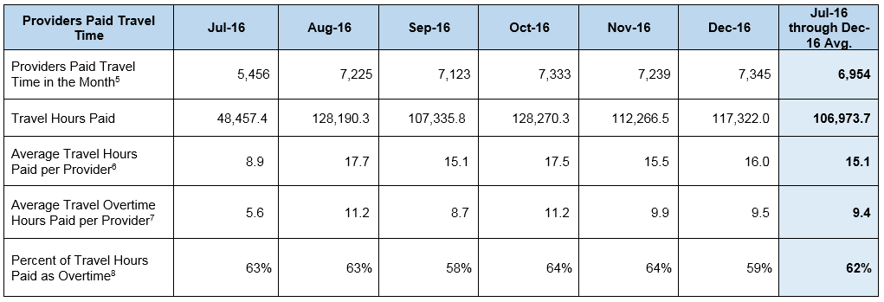
IHSS/WPCS Providers Paid Travel Time

Slide 13
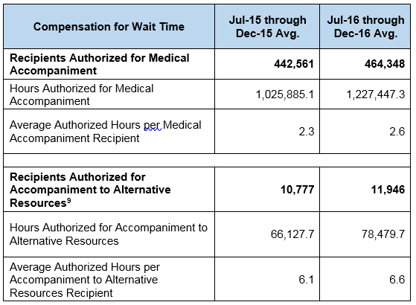
Compensation for Wait Time

Slide 14
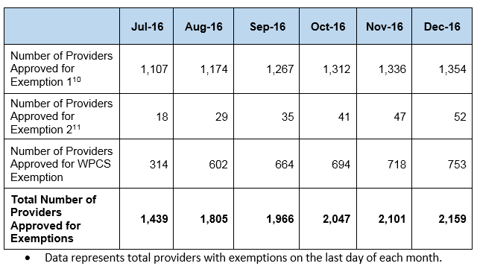
IHSS/WPCS Providers Approved for Overtime Exemptions

Slide 15
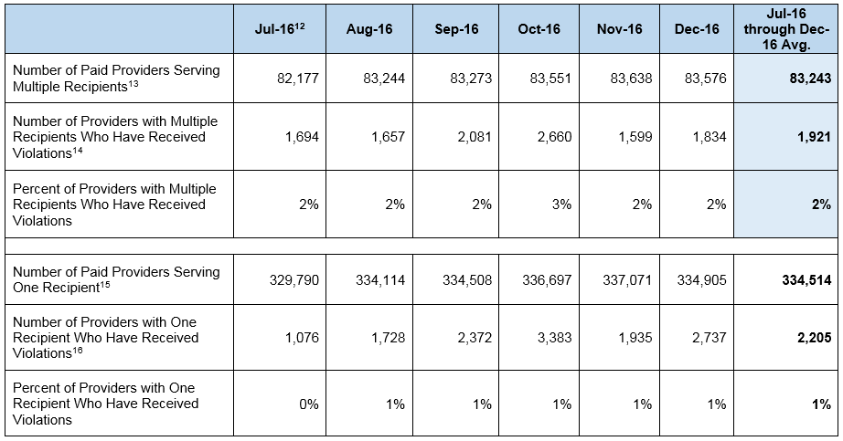
IHSS/WPCS Providers Receiving Violations

Slide 16
IHSS/WPCS Providers with Violations

Slide 17
Electronic Timesheets
CDSS has been working with stakeholders including providers, recipients, labor organizations, counties, CWDA and CAPA to implement a voluntary electronic timesheet option. This will expedite provider payments by eliminating mailing time for timesheets. It also will support accurate timesheet completion, and prevent provider overtime violations by giving immediate feedback to the provider while they are completing a timesheet.
The electronic timesheet functionality can benefit all providers, even those who do not enroll in the electronic timesheet service, because they will be able to create an online account and view the history of processed timesheets including payment information, hours submitted and any exception messages.

Slide 18
Electronic Timesheets – Timeline and Activities
December 2016 – User group sessions were conducted with IHSS providers and recipients to solicit direct feedback from them on the new electronic timesheet service.
January 2017 – Conducted stakeholder group sessions to provide an overview of the electronic timesheet service to counties, public authorities and the labor organizations.
March 2017 – Draft ACL is scheduled to be released for stakeholder review.
April 2017 - CDSS will send outreach mailing to the recipients and providers in the pilot counties.
May 2017 – Implement in the three pilot counties – Sacramento, Yolo and Riverside.
July 2017 – Target date for statewide implementation pending the outcome of the pilot.

Slide 19
Electronic Visit Verification
The Federal 21st Century Cures Act was signed December 2016. It mandates all states to require Electronic Visit Verification (EVV) by January 2019.
EVV requires capturing daily start and stop time, and the type of each service provided. Neither are currently captured in the IHSS Program.
CDSS is assessing these new requirements and their impact to the IHSS program. Any approach for implementation will include extensive stakeholder participation.

